Slide 1
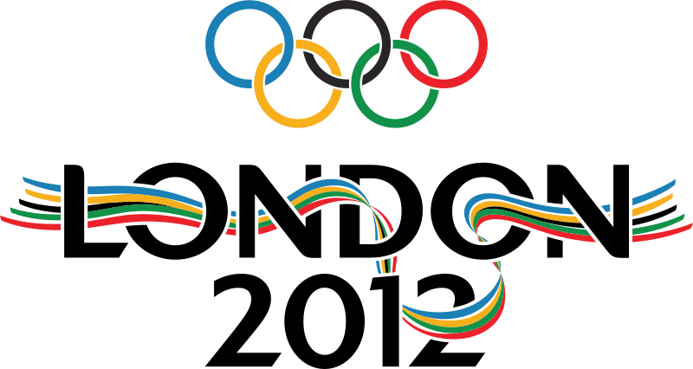
The Olympic Games

Slide 2
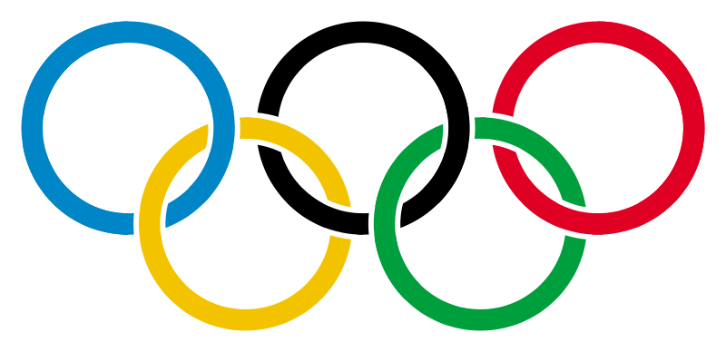
London will host the Olympic Games this year.
The 2012 Summer Olympics are planned to take place between 27 July 2012 and 12 August 2012.
It was confirmed in February that Queen Elizabeth II and the Duke of Edinburgh will officially open the games at the opening ceremony.

Slide 3
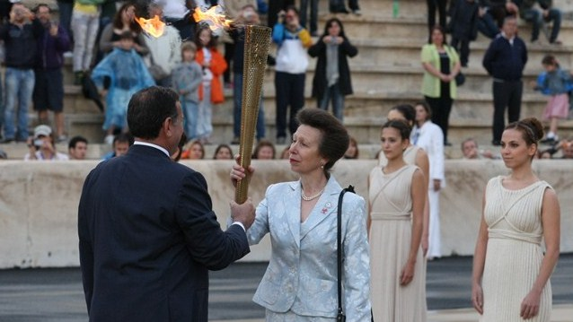
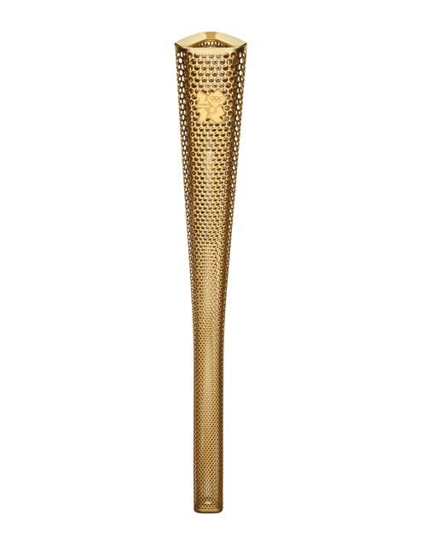
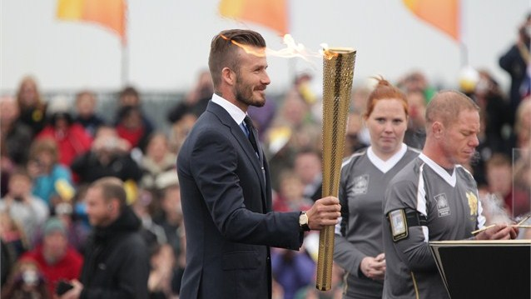
Bearers of the Olympic torch relay across the England are famous people like David Beckham and Princess Anne.
the Olympic Torch

Slide 5
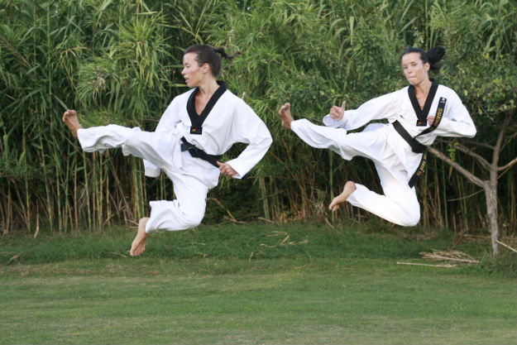
Croatia in London
People in Croatia expect a lot from sisters Zaninović in taekwondo.

Slide 6
Sports

Slide 7
The Olympic logo this year.

Slide 8
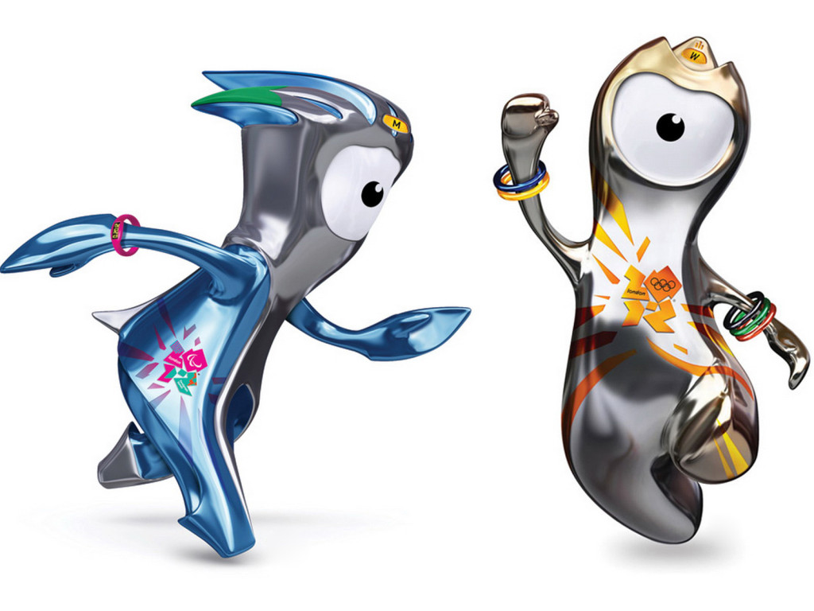
Olympic mascote
Mandeville’s name comes from Stoke Mandeville Hospital in Aylesbury.
Wenlock and Mandeville are the official mascot for the 2012 Summer Olympic.
Wenlock’s name is inspired by Munc Wenlock in Shropshire, England.

Slide 10
Questions
Where will the Olympic Games take place this year?
When do the Games start?
Name a few Olympic sports!
Name at least one Croatian sportsperson in London!
Who are Wenlock and Mandeville?

Slide 11
Thank you for your attention! Tin Novosel and Fran Blažeka for the eTwinning project “London Olympics 2012”, May 2012

