Slide 1
On the Track of Our Recent Past Early laptops
eTwinning project

Slide 2
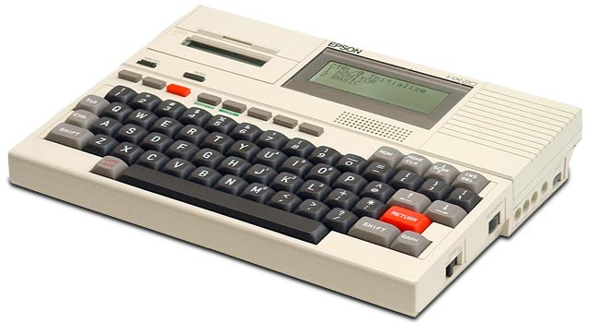
Epson HX-20
The Epson HX-20 is generally regarded as the first laptop computer, announced in November 1981, although first sold widely in 1983.
https://en.wikipedia.org/wiki/Epson_HX-20

Slide 3
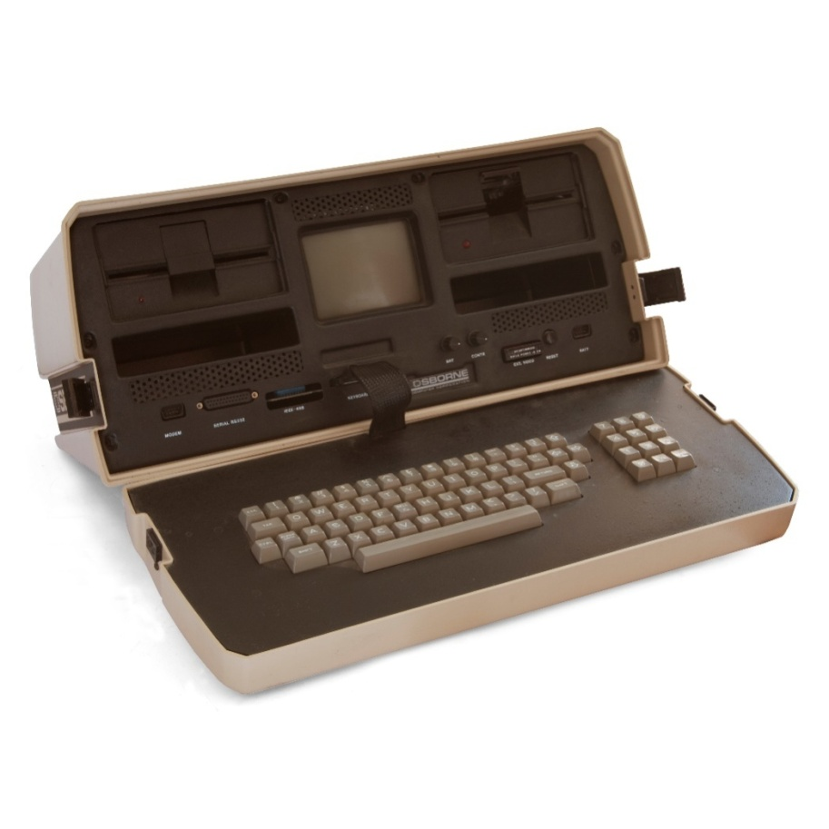
Osborne 1
The Osborne 1 was the first commercially successful portable
microcomputer, released on April 3, 1981 by Osborne Computer Corporation.
https://hr.wikipedia.org/wiki/Osborne_1

Slide 4
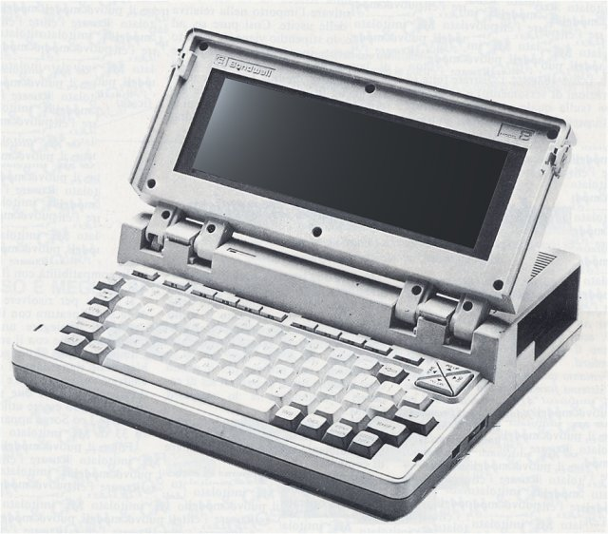
Bondwell 2
Although it wasn't released until 1985, well after the decline of CP/M as a major operating system, the Bondwell 2 is one of only a handful of CP/M laptops.
https://en.wikipedia.org/wiki/Bondwell-2

Slide 5
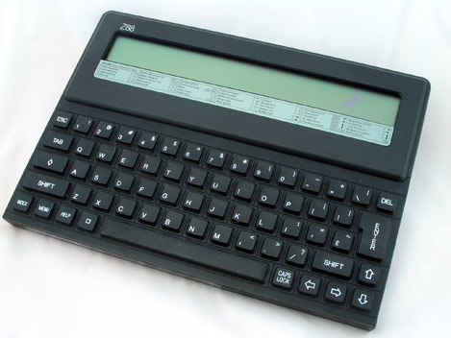
Cambridge Z88
Cambridge Z88, designed by Clive Sinclair, introduced in 1988.
https://cambridgez88.jira.com/wiki/display/welcome/Cambridge+Z88

Slide 6
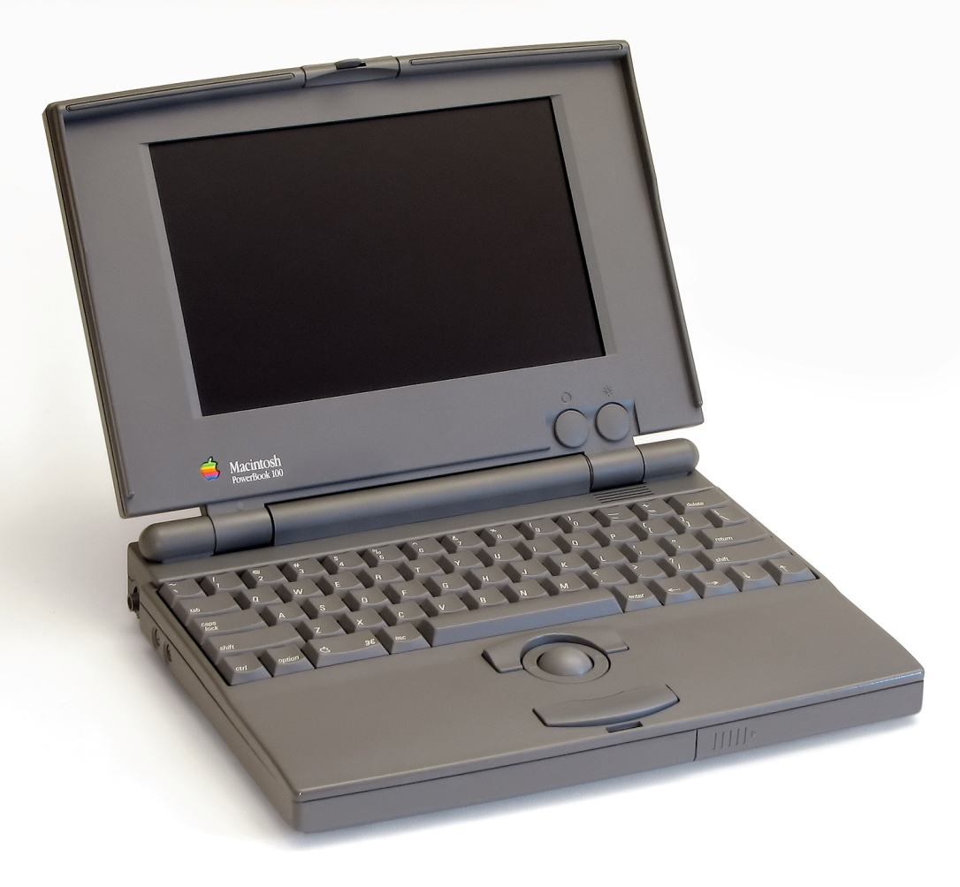
Apple PowerBook 100 Specs
In October 1991, Apple Computers released the Macintosh PowerBook 100
http://www.everymac.com/systems/apple/powerbook/specs/mac_powerbook100.html

Slide 7
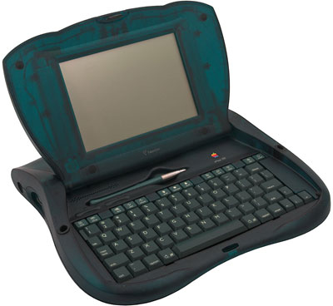
Newton eMate 300
A mini laptop form factor of the Newton introduced in March 1997.
http://www.roughlydrafted.com/2008/08/30/two-decades-of-portable-macs-1989-2009/

Slide 8
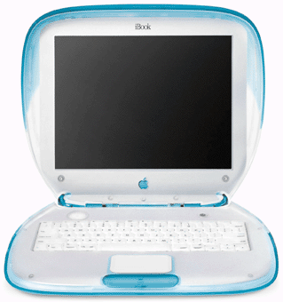
iBook
It was also the first laptop to offer integrated support for WiFi wireless networking from 1999.
https://en.wikipedia.org/wiki/IBook

Slide 9
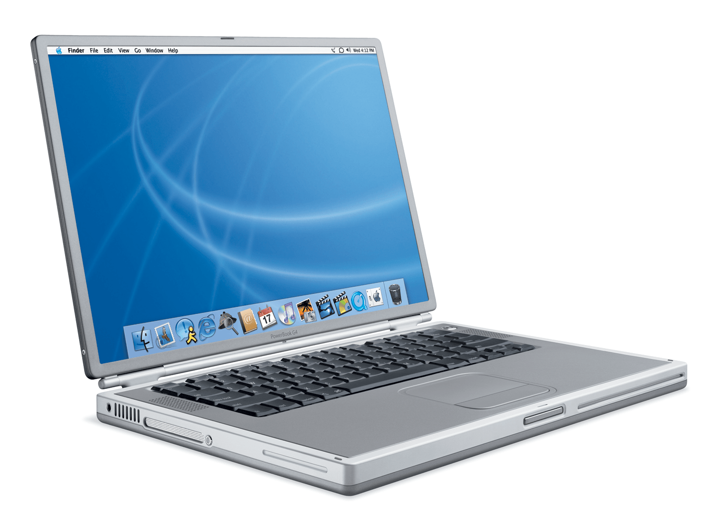
PowerBook G4 Titanium
Jobs introduced the thin new 15” titanium PowerBook G4 in 2001.
https://en.wikipedia.org/wiki/PowerBook_G4

Slide 10
Paola Oltran, 6th grade
II. osnovna škola Čakovec
Teacher: Iva Naranđa
Croatia

