Slide 1
Agfa silette lk sensor

Slide 2
Agfa silette lk sensor
The Silette LK differs from the Silette L by a coupled light meter and a shorter exposure time of 1/250 sec, but had the same lens.

Slide 3
Agfa Silette LK Sensor is a 35mm film viewfinder camera made by Agfa, Germany and introduced in 1969.

Slide 4
Silette LK Sensor
The Silette LK sensor corresponded extensively Optima 200 Sensor, was a camera with manual exposure.

Slide 5
Plastic body, metal chrome finished top and bottom plates and a black leatherette covering.
Red "Sensor" shutter release button is the distinctive mark of Agfa cameras in the seventies.
It was probably the shortest and softest shutter release pressure in its time.

Slide 6
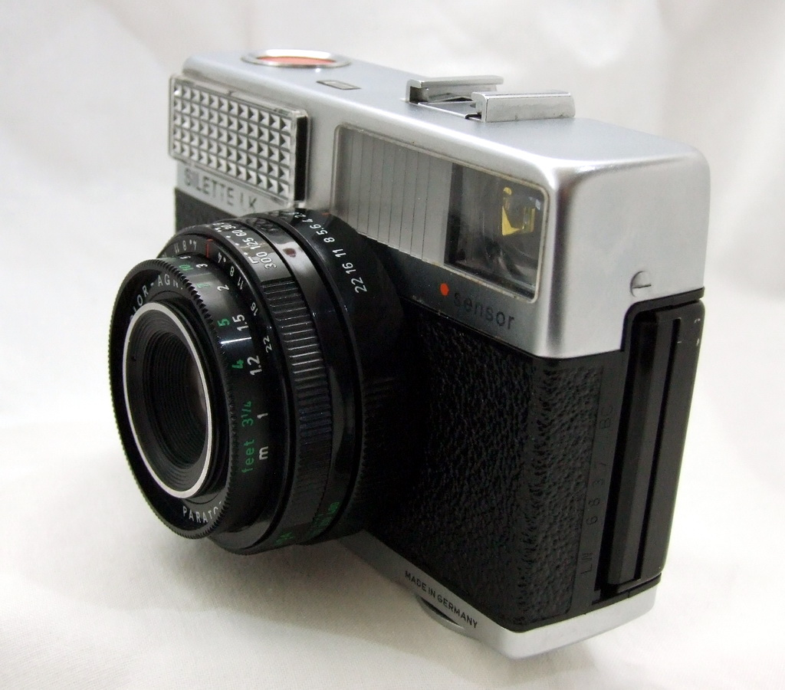

Slide 7
SOURCES:
http://camerapedia.wikia.com/wiki/Agfa_Silette_LK_Sensor
http://www.thecamerasite.net/07_Viewfinder_Cameras/Pages/agfa-silette.htm

Slide 8
Deniz Dadić, 7.b
Teacher: Iva Naranđa
II. osnovna škola Čakovec, Croatia
eTwining project „On the Track of Our Recent Past”
April 2016

