Slide 1
Kućna računala s početka 80-ih
Home PCs - the beginning of the 1980s
eTwinning project “On the Track of Our Recent Past”, Mario Olčar, 7.b, 24.1.16, teacher Iva Naranđa, II. osnovna škola Čakovec, Croatia

Slide 2
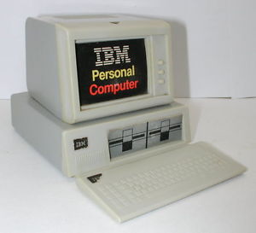
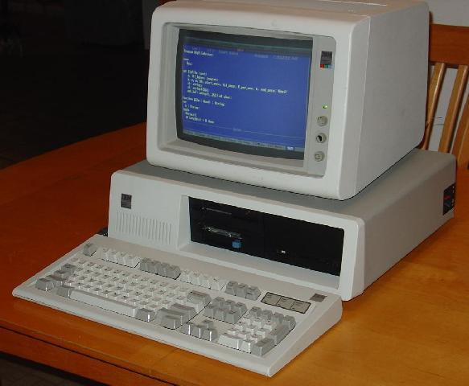
First computers
IBM PC (model 5150)
12.08.1981
IBM PC (model 5150)
Operating system: IBM BASIC / PC DOS 1.0 CP / M-86 UCSD p-sustav CPU Intel 8088 4,77 MHz Memory: 16 KB ~ 256 KB

Slide 3
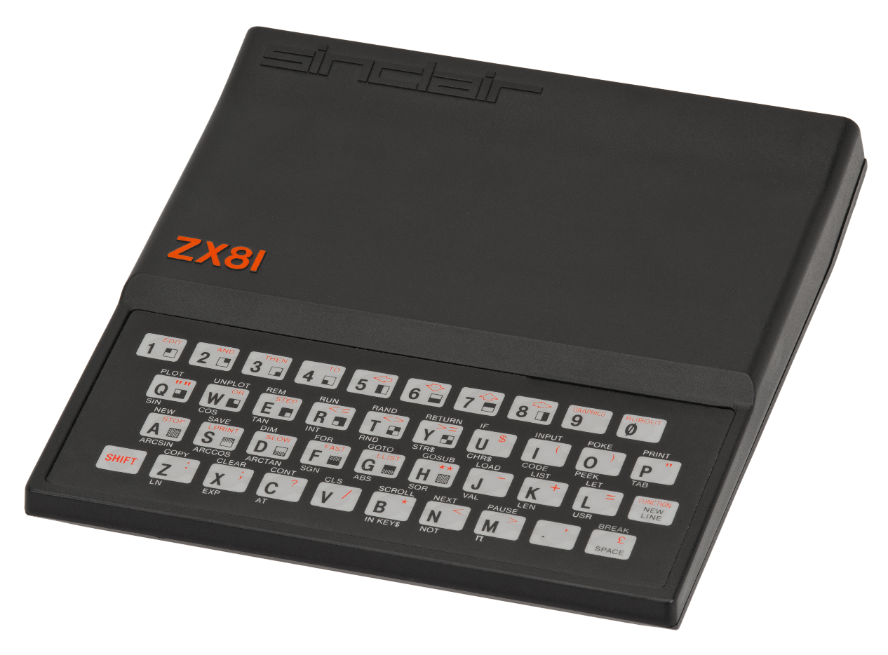
ZX-81
1981 CPU: NEC Z-80A, 3.25 MHz RAM: 1 Kb, 64 Kb max. OS: ROM BASIC

Slide 4
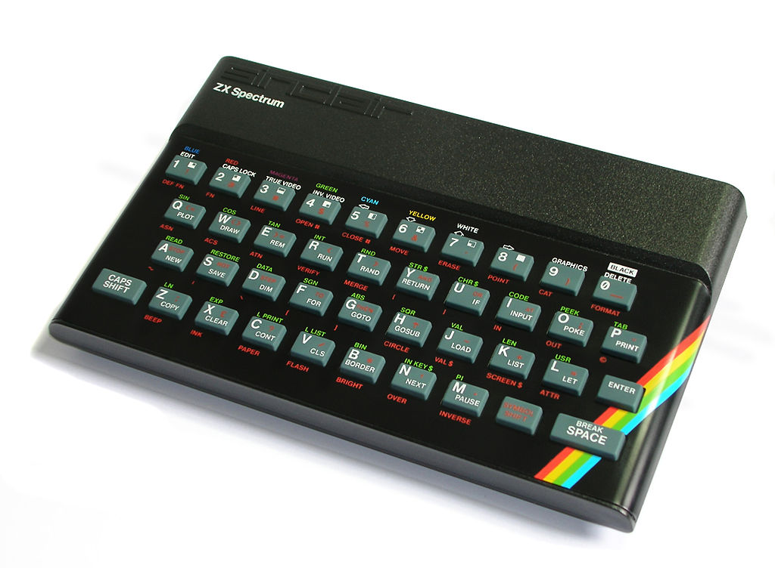
ZX Spectrum
Microprocessor : Zilog Z80
Tact: 3,5 Mhz
ROM: 16 KB
RAM: 48 KB
Graphics 256*192 15 colors
Operating system BASIC

Slide 5
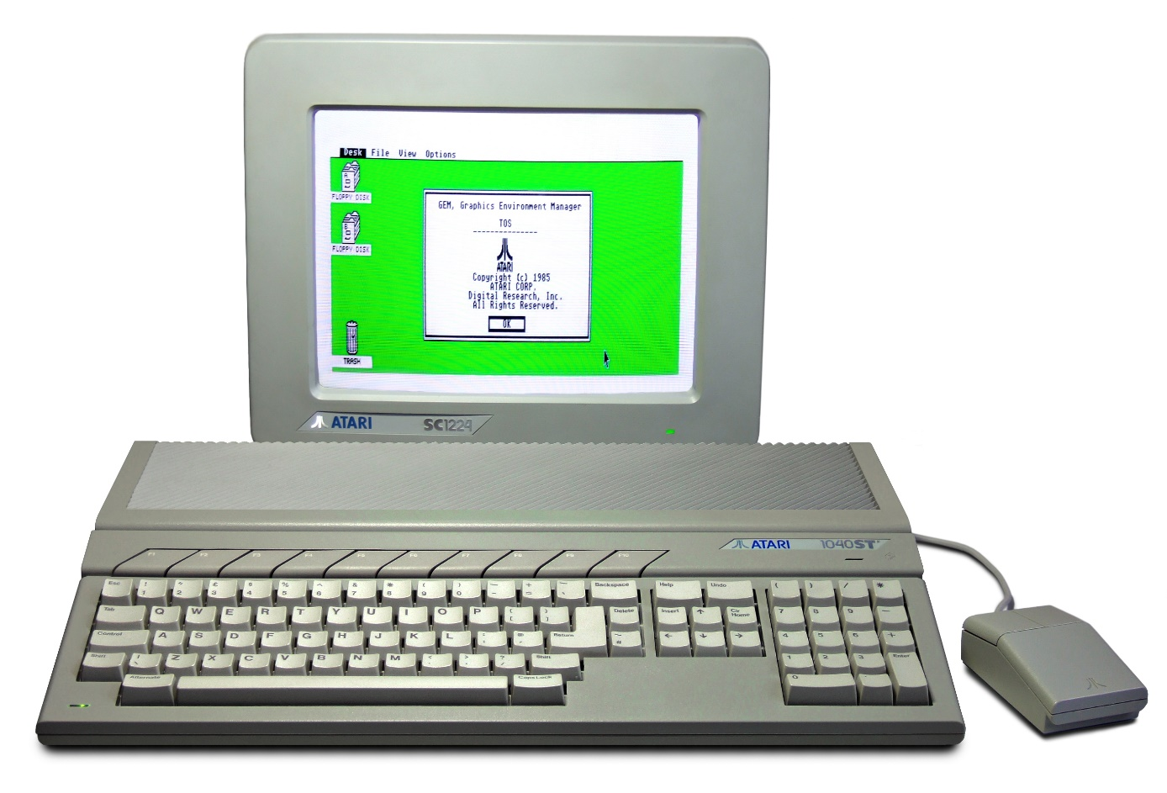
Atari ST
1985 Operating system Digital Research's GEM run via Atari TOS CPU Motorola 680x0 @ 8 MHz Memory 512 Kibibyte (512 × 210 B) - 4 Mebibyte (4 × 220 B)

Slide 6
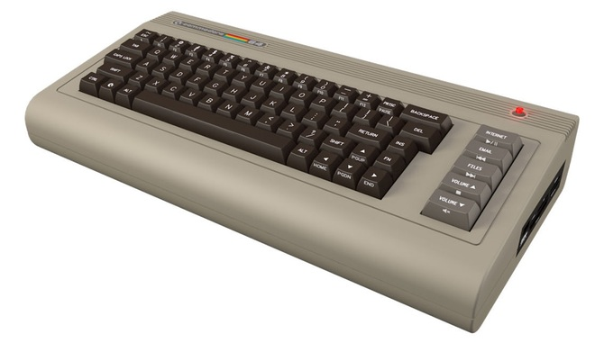
Commodore 64
CPU: MOS Technology 6510/8500 @ 1.023 MHz (NTSC version) @ 0.985 MHz (PAL version Graphics: VIC-II (320 × 200, 16 colors, sprites, raster interrupt) memory: 64 kB RAM + 20 kB ROM sound: SID 6581 (3× osc, 4× wave, filter, ADSR, ring)

Slide 7
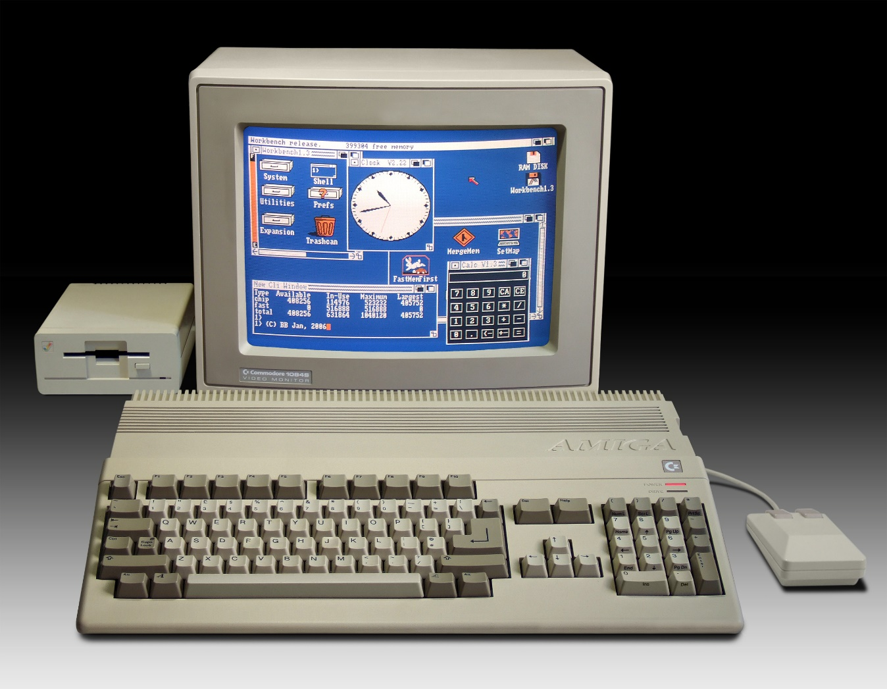
AMIGA
July 1985 (Amiga 1000)
AmigaOS on Kickstart
CPU : Motorola 680x0 @ ≈7 MHz & higher
Memory : 256 kilobytes and higher, expandable

Slide 8
SOURCES
https://en.wikipedia.org/wiki/IBM_Personal_Computer
https://hr.wikipedia.org/wiki/Osobno_ra%C4%8Dunalo
https://hr.wikipedia.org/wiki/ZX_81
https://hr.wikipedia.org/wiki/ZX_Spectrum
https://en.wikipedia.org/wiki/Commodore_64
https://en.wikipedia.org/wiki/Atari_ST

