Slide 1
Kućna osobna računala s početka 1980-ih
Home PCs - the beginning of the 1980s
II. Osnovna škola čakovec, CROATIA
eTwinning projeCt „On the Track of Our Recent Past”
Lovro žbulj 7.b
18.1.2016
TEACHER: Iva naranđa

Slide 2
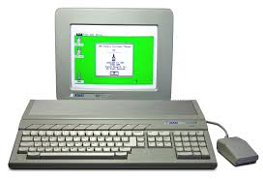
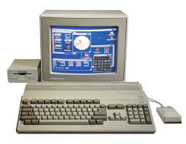
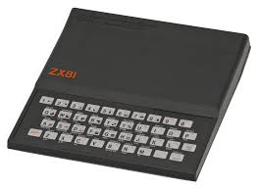
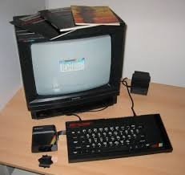
Home PCs - the beginning of the 1980s
Atari ST
Commodore 64/Amiga
ZX 80/ZX 81
ZX Spectrum

Slide 3
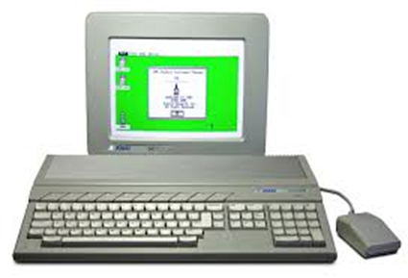
Atari ST
OS - Digital Research's GEM run via Atari TOS
CPU- Motorola 680x0 @ 8 MHz & higher
Memory - 512 Kibibytes (512×2¹⁰ bytes) to 4Mebibyte (4×2²⁰ bytes)

Slide 4
Commodore 64/Amiga
Commodore 64
OS - Commodore KERNAL/Commodore BASIC 2.0 GEOS (optionally)
CPU - MOS Technology 6510/8500@ 1.023 MHz (NTSC version)@ 0.985 MHz (PAL version)
Memory - 64 kB RAM + 20 kB ROM
Graphics - VIC-II (320 × 200,16 colors, sprites, raster interrupt)
Amiga
OS – AmigaOS on Kickstar
CPU - Motorola 680x0 @ ≈7 MHz & higher
Memory - 256 kilobytes and higher, expandable

Slide 5
ZX 80/ZX 81
OS - Sinclair BASIC
CPU - Z80 @ 3.25 MHz (most machines used the NEC μPD780C-1 equivalent)
Memory - 1 KB (16 KB max.)

Slide 6
ZX Spectrum
OS - Sinclair BASIC
CPU - Z80 @ 3.5 MHz and equivalent
Memory - 16 KB / 48 KB / 128 KB

Slide 7
Sources:
https://en.wikipedia.org/wiki/ZX_Spectrum
https://hr.wikipedia.org/wiki/ZX_81
https://en.wikipedia.org/wiki/Amiga
https://hr.wikipedia.org/wiki/Commodore_64
https://hr.wikipedia.org/wiki/Atari_ST

